Slide 1

PREDICTIVE MODEL BUYING BEHAVIOUR
22-04-2022

Slide 2
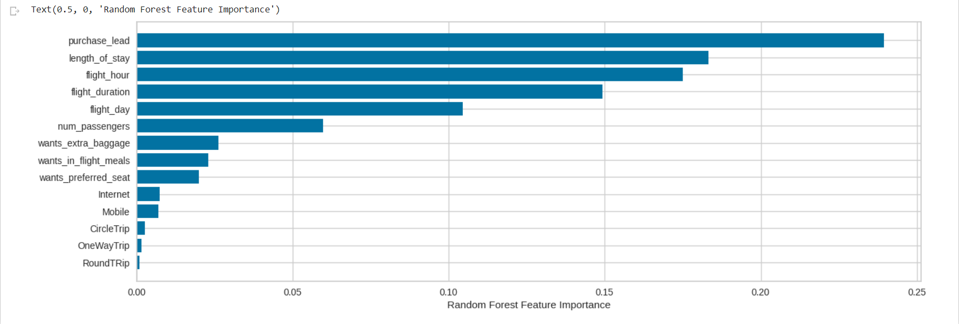
PREDICTIVE MODEL BUYING BEHAVIOUR
Dataset was balanced with 8k labelled as incomplete
bookings and 7k as complete bookings. Top features that can drive successful flight bookings.
Will be predicted as actually completed bookings out of all successfully completed bookings.
Chance of predicting true successful bookings.
64% Chance of predicting true incomplete bookings correctly.
ACCURACY
62%
PRECISION
61%
RECALL RATE
59%
F1 SCORE
6%

